Slide 1
Women Feeding Cities Building a Gender-Transformative, Resilient, and Sustainable Informal Food Sector for
COVID-19 Recovery
New Frontiers in Research Fund Mid-Term Forum, 12-13 September 2024
2022 Special Call for Post-Pandemic Recovery

Slide 2
Women Feeding Cities Project Team
Jonathan Crush
Andrea Brown
Elizabeth Onyango
Maria Salamone
Sujata Ramachandran
Zhenzhong Si
Mercedes Eguiguren
Heba Hamzeh
Laeba Khan
Adwoa Konadu-Yiadom
Natalie Dietrich Jones
Stephen Johnson
Jonathan Lashley
Latoya Lazarus
Ndeyapo Nickanor
Tobias Shinyemba
Godfrey Tawodzera
Lawrence Kazembe
Ines Raimundo
Filipe Mate
Ezequiel Alfeu Abrahamo
Alda Saúte Saíde
Guénola Capron
Tiana Bakic Hayden
Salomon Gonzalez Arellano
Fernanda Vásquez

Slide 3
Project Description
Identify how the COVID-19 crisis disrupted livelihoods and well-being of women entrepreneurs and workers in the informal food retail sector in selected Global South cities: Kingston (Jamaica), Mexico City (Mexico), Maputo (Mozambique), and Windhoek (Namibia).
Assess the socioeconomic, health and food security outcomes of COVID-19 public health containment and mitigation responses for these workers and their households.
Conduct detailed survey of 950 (800 women and 150 male) entrepreneurs and 300 employees, 20 key informant interviews, 25 in-depth interviews, 3 focus groups, participant observation, and 1 photovoice study in each city.
Provide gender-responsive comparative, locally relevant evidence base to support sustainable post-COVID recovery of the informal food sector.

Slide 4
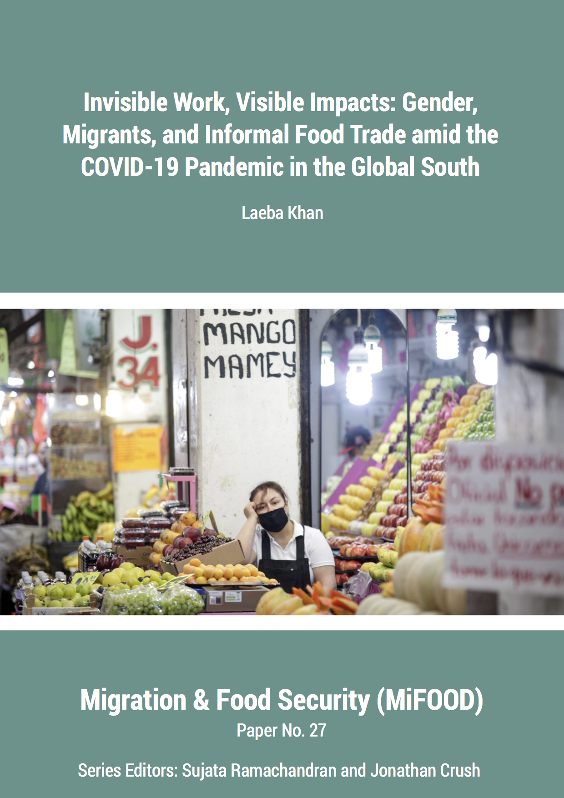
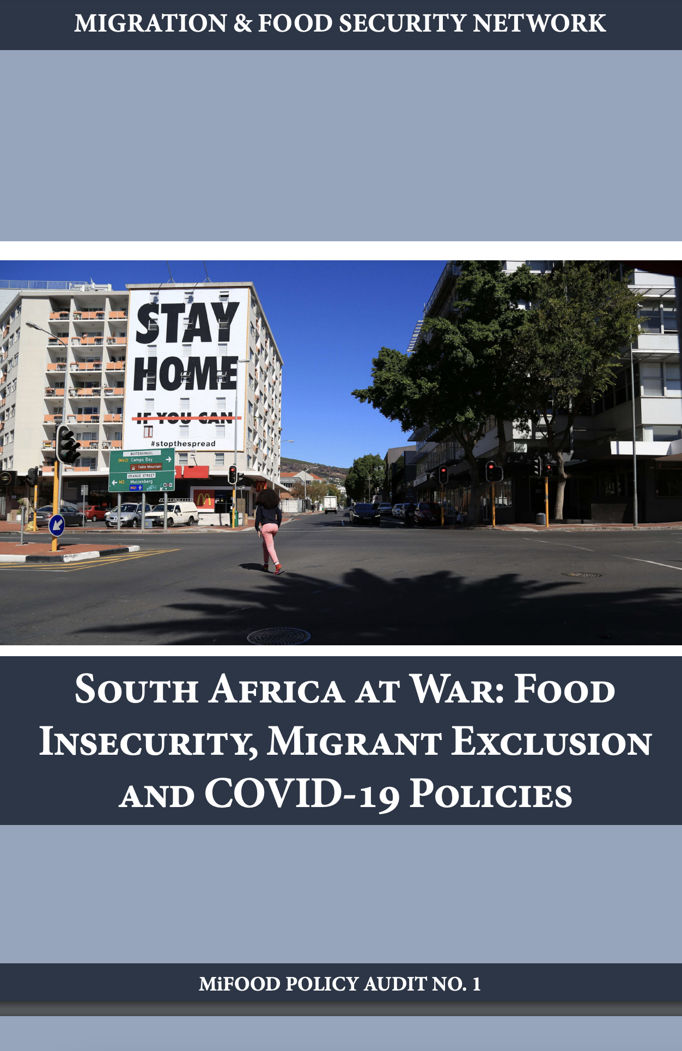
Important Outcomes
Mentorship and training graduate students
Policy audit reports for individual country study sites
https://mifood.org/

